Slide 1
PROJECT I

Slide 2
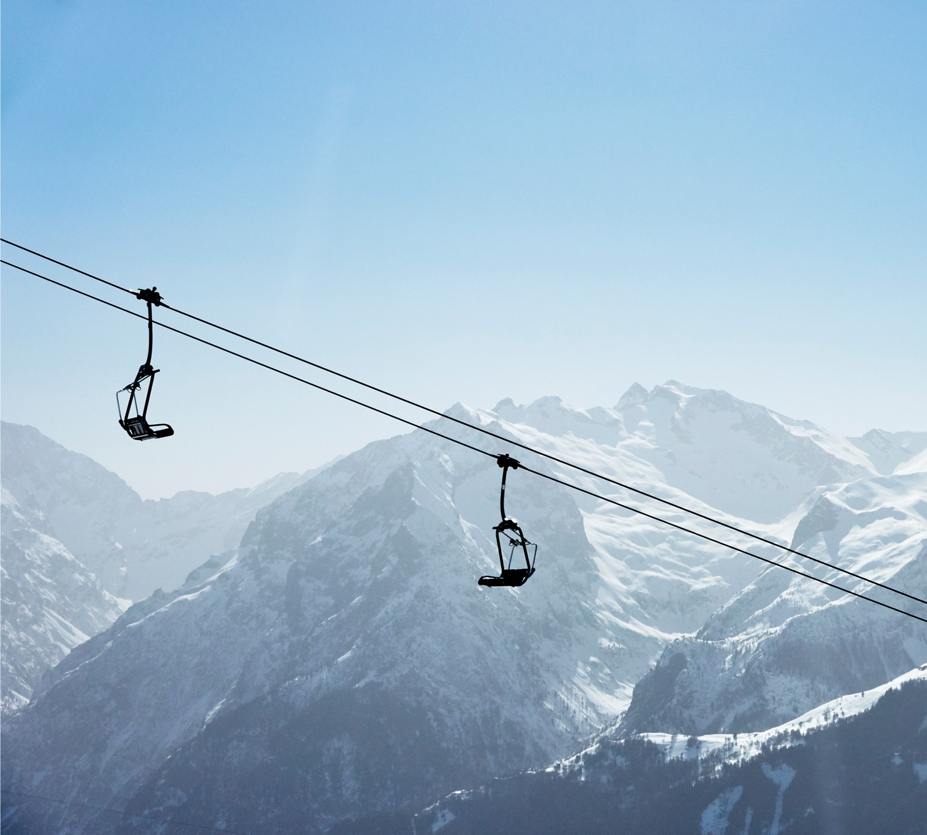
Agenda
Introduction
Building confidence
What are we going to do?
Our tasks
Final tips & takeaways

Slide 3
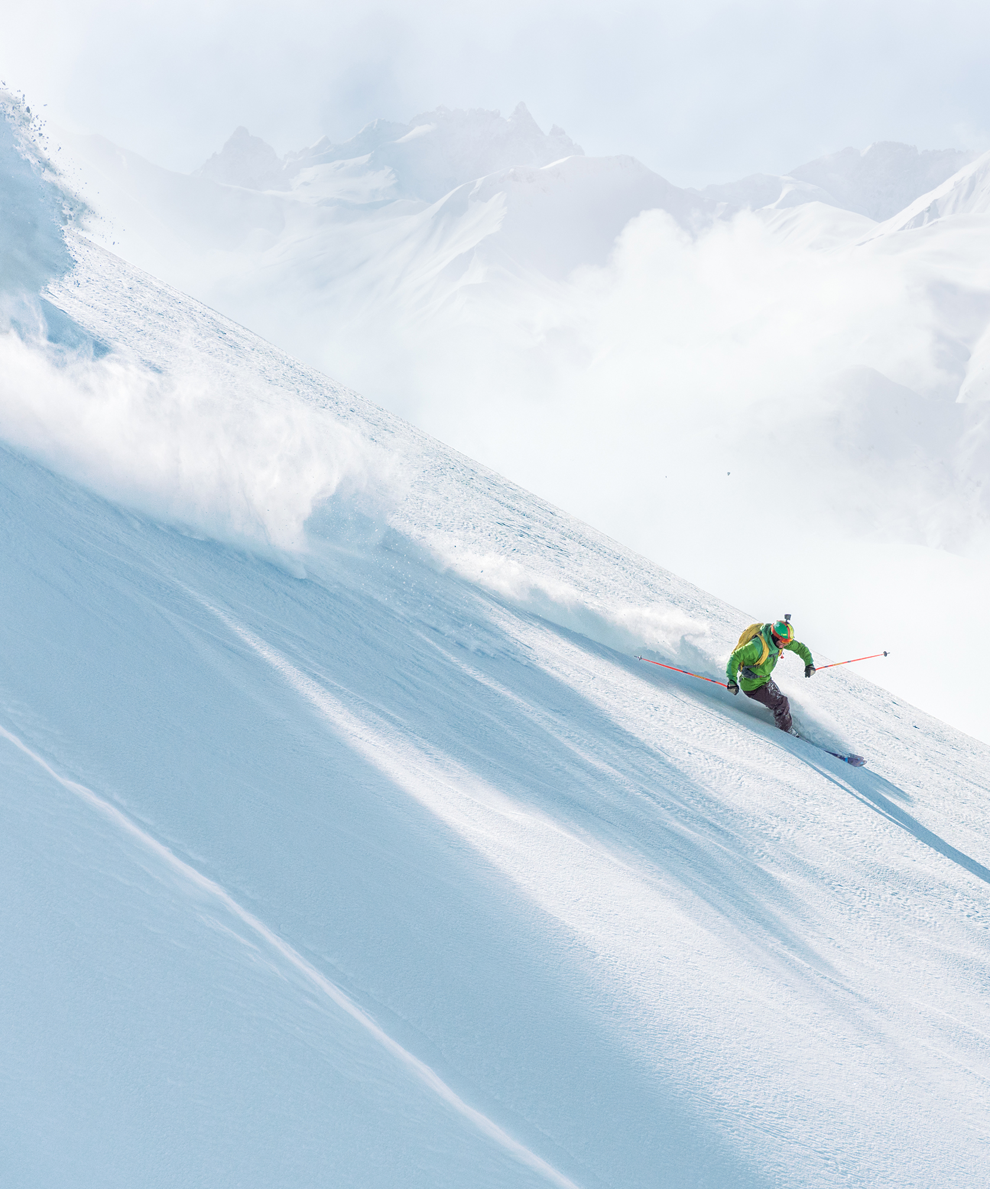
Introduction

Slide 4

Building Confidence
Setting precedence
Do it today, do it again
IGNORE IT TODAY, LAG BEHIND

Slide 5
What are we going to do?
Create a project using C
Create a proposal for our project
Create a documentation of our project for project defense
Create a presentation to showcase our project
Create a team for our project

Slide 6
C

Slide 7
Basics
Using C
Using Files
Using Loops
Using Structures
Using Functions
Using Switch case statements
Using if/else
Creating a menu-based system
Authentication
Your choice

Slide 8
RULES
Each team can have at most 3 members
Each member must contribute to project
Proposals must be submitted before project commencement
Proper dress and admit card is required during project defense (external viva)
Project topic must be selected by the students themselves
Project topics must be unique

Slide 9

Q&A

Slide 10
Thank you
One project with excellent concept, documentation and presentation will be selected to be example for further batches
Kushal Niroula
niroulakushal31@gmail.com
https://kusalniroula.com.np/

